Slide 1
MODULE – 1 COMPUTER NETWORKS

Slide 2
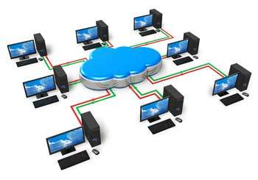
Computer Networks
A collection of autonomous computers interconnected by a single technology
For sharing data & resources
Two computers are said to be interconnected if they are able to exchange information
Nodes: Computers on network
Connection: via copper wire, optical fiber, microwave, infrared
Internet : Not a single network
A network of networks

Slide 3
Uses
Business Applications
Home Applications
Mobile Uses
Business Applications
Helps in resource sharing – Programs, Equipments, data etc…
Eg: Group of office workers sharing a common printer
Larger companies – Employees at different locations or continents

Slide 4
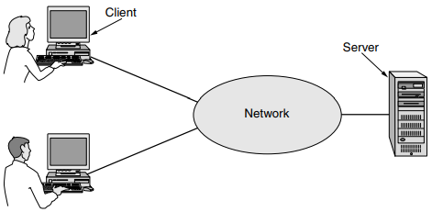
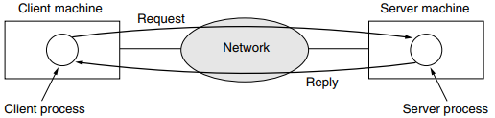
Client-Server model
Server ?
Two processes
Client process sending a message over the network to the server process. The client process then waits for a reply message.
When the server process gets the request, it performs the requested work or looks up the requested data and sends back a reply

Slide 5
Provide powerful communication media among employees
Eg: email communication, video conferencing
Doing business electronically :
Eg: e-Commerce

Slide 6
Home Applications
Include
Access to remote information
Browsing, online news paper, online digital libraries
Person to person communication
Email, instant messaging, chat room
Interactive entertainment
Online games, Live TV
E-commerce
Home shopping, online technical support, Online payments, auctions etc

Slide 7
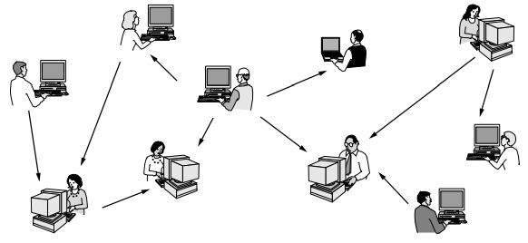
Peer-to-peer communication
Person to person communication
No fixed division of clients & servers

Slide 8
Mobile Users
Portable office:
Using wireless n/w
Mobile with internet:
Send & receive data & information and log on to remote machines

Slide 9
Network Hardware
2 types of transmission technologies
Broadcast links and
Point-to-point links
Broadcast links
Single communication channel share by all the machines on the network
Short messages – Packets : Send by one machine → receive by all
After receiving check the address field → Process / Ignore
Multicasting

Slide 10
Point-to-point links
Provides a dedicated link b/w devices
Entire line reserved for transmission b/w 2 devices
Also called Unicasting
FIG

Slide 11
LAN
Privately owned network within a single building
Up to few KMs in size
Widely used to connect PCs & workstations in offices/ companies & exchange data
Different types based on
Size
Transmission technology
Topology
FIG

Slide 12
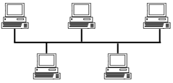
Topologies
Bus Topology
At any instant one machine is master & is allowed to transmit
Arbitration mechanism is needed → More than one want to transmit
Arbitration → Centralized or distributed
Ethernet:
Bus based broadcast network with decentralized control
Operating at 10mbps – 10gbps
If 2 packet collide → each wait a random time and try again later

Slide 13
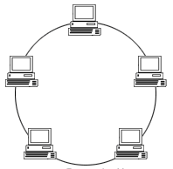
Ring Topology
Some rules will be there for simultaneous access of ring
Like round robin, time quota etc
Network can be
Static
Dynamic

Slide 14
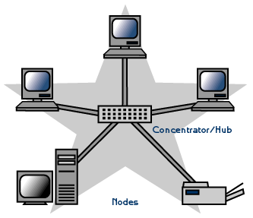
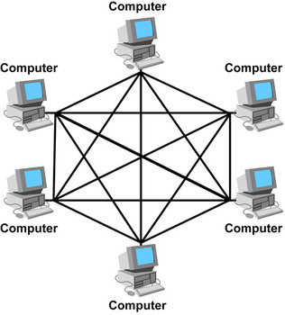
Star Topology
Mesh Topology
Fully connected mesh has n(n-1)/2 physical channels

Slide 15
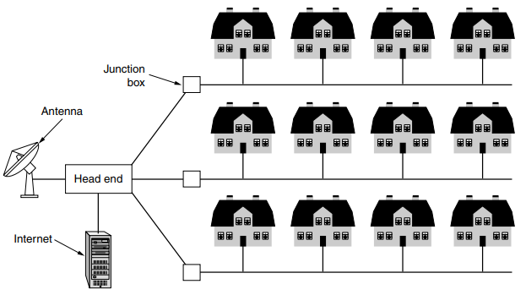
MAN
Covers a city
Eg: Cable television
Contains a no of LANs

Slide 16
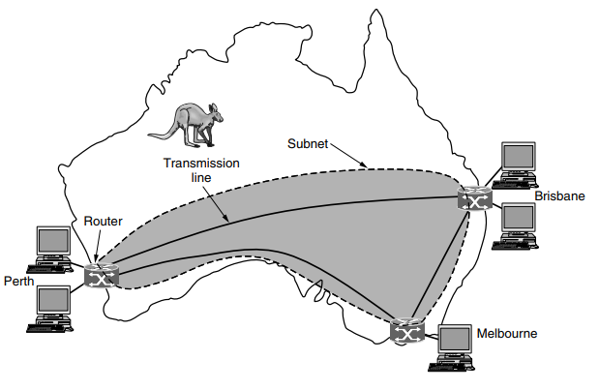
WAN
Spans a large geographical area → country or continent
Long distance transmission of data, voice, image & video
Hosts connected by a communication subnet
Subnet : Carry messages from host to host
Hosts Owned by → Customers
Subnet → Telephone company or ISP

Slide 17
Subnet consist of 2 distinct components:
Transmission lines:
Move bits b/w machines
Made of copper, Optical fiber, radio links etc
Switching elements:
Specialized computers that connect 2 or more transmission lines
When data arrives on incoming lines, switching element choose an outgoing line to forward it
Switching components → called as Router
Fig

Slide 18
Packet switched/ Store & forward Network
Packet ?
2 routers that don’t share transmission line want to communicate → Inter mediate router
Store the packet & check the output line → forward when it is free
Decision to take the intermediate router → Routing algorithm
Another possibility of WAN : Satellite system

Slide 19
Internetworks
Collection of interconnected Networks
Common form → LANs connected by a WAN
FIG
Combination of subnet and its hosts
Sub networks may be distinct

Slide 20
Difference b/w LAN & WAN
Difference b/w LAN & MAN
Application level questions

Slide 21
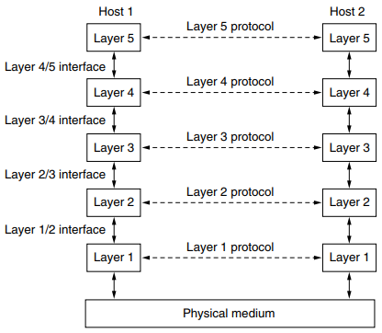
Network Software
Protocol Hierarchies
To reduce design complexity → N/w organized as stack of layers/ levels
Each one built on one below it
No, name, content & function differs from n/w to n/w
Each layers → offers services to the layers above & below it
Eg: 5 Layer N/w

Slide 22
Communication with same level : On another machine
Rules used for this communication → Protocol
Agreement b/w communicating parties
Peers:
Entities in each layers
Peers communicate each other by using protocols
Reality : Each layer to the layer below it → Physical medium
Interface:
Between each layer
Defines which primitive operations & services the lower layer makes available to upper layer

Slide 23
Network architecture
Set of layers & protocols
Specification must contain enough information
Protocol Stack
List of protocols used by a certain system, one protocol per layer

Slide 24
Communication Process
5 layer n/w
L5 breaks →give to L4
L4 breaks → put header in front of it to identify → pass to L3
Header : Include control information
Eg: Sequence no to allow destination machine to deliver message in order
Time, size and other control fields
At the receiver:
Message move upwards from layer to layer
Header remove in each layer

Slide 25
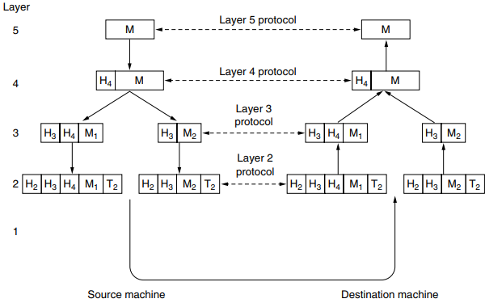

Slide 26
Design issues for the layers
Mechanism for identifying sender & receiver
Rules for data transfer
Error control
Loss of sequencing
Keep a fast sender from swamping a slow receiver
Inability of all process to accept arbitrarily long messages
Inconvenience or expensive to setup separate connection
Routing

Slide 27
Mechanism for identifying sender & receiver
Network has many computers & some has multiple processes
Some mechanism needed for process on one machine to specify with whom it want to talk
Some form of addressing needed to specify a destination
Rules for data transfer
Some system → data travels only one way
Other both ways
How many logical channel needed
Priority etc

Slide 28
Error control
An important issue since physical communication circuits are not perfect
Many error detection and correction codes are known
But both end must agree on which one is used
Some mechanism needed → to inform the sender → if not reached correctly
Loss of sequencing
Dividing & reassembling
Sequence number
Keep a fast sender from swamping a slow receiver
Give feedback
Limit the sender to an agreed up on transmission rate → Flow control

Slide 29
Inability of all process to accept arbitrarily long messages
Long messages → disassembling & reassembling messages
Another issue : sending as very small data units
Solution : Gather several small messages and send as one message
Inconvenience or expensive to setup separate connection
Unavailability of transmission media
Routing
Which way to choose if more than one path available

Slide 30
Interface
Layered network → b/w each pair of adjacent layers
Defines which primitive operations & services the lower layer gives to upper layer
One of the important considerations while planning a n/w layers
Here each layer should perform a specific collection of function
Minimize the amount of information that must be passed b/w layers
Also make it simpler to replace the implementation of one layer with a completely different implementations
Eg: telephone lines replace with satellite channel
The new implementation should offer exactly the same set of services to its neighboring layers as the old implementations

Slide 32
Connection oriented VS Connection less service
Layers can offer 2 different types of services
Connection oriented:
Establish a connection, use it and then release
Pipe
Most cases order is preserved
TCP
Connection less service
No connection establishment
Order issue
UDP
Select depends on the situations

Slide 33
Quality of Services (QoS)
Reliable:
Receiver acknowledge
File transfer : Owner need to make sure that it reached correctly
Reliable connection oriented service has a variations
Message sequence
Message boundaries preserved
If sent as two1024 bytes, it shouldn't arrive as 2048
Byte stream
Simple Stream of bytes
No message boundaries

Slide 34
Unreliable connectionless service
Message receipt not acknowledged
High probability of receiving, but not guaranteed
Also called Datagram service
Acknowledged Datagram Service
In some situations : Not able to establish a connection, But need reliability
Sender send message and request for a return receipt
Request- Reply Service
Sender transmit a single datagram containing a request
Reply contain the answer
Commonly used in Client server communication

Slide 35
Service Primitives
A service is formally specified by a set of Primitives
Operations
These primitives tell the service to perform some action
Primitives are normally system calls
Set of primitives available depends on the nature of service being provided
Ie primitives for connection orient service are different from connection less service

Slide 36
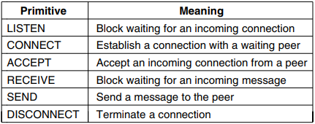
Eg: Service primitives to implement a reliable byte stream in a Client – Server Environment

Slide 37
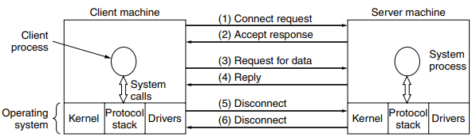
Usage of this Primitives
LISTEN
CONNECT
RECEIVE
SEND followed by RECEIVE
SEND
DISCONNECT
DISCONNECT

Slide 38
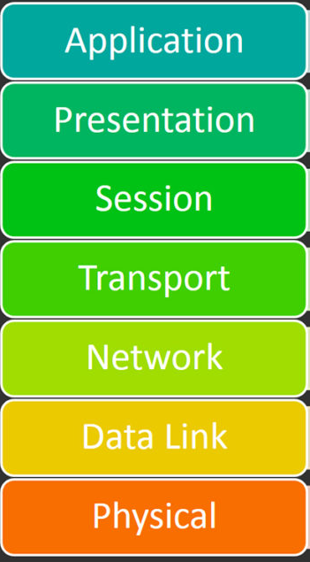
OSI - Reference model
ISO – Open system interconnect
Open system
Why 7 layers?
Physical Layer
Data Link Layer
Network Layer
Transport Layer
Session Layer
Presentation Layer

Slide 39
Physical Layer :
Row bits
Electrical and mechanical specification
Design issues: if send 1 → receive as 1 not 0
Duty: Data rate, Representation &synchronization of bits
Data Link Layer
Frames → hundreds or thousands of bytes
Duties: Framing, Flow control, Error Control
Makes the upper and lower layers error free
Design issue: Flow control(eg: Fast sender), Error control

Slide 40
Network Layer
Controls the operation of subnet
Packets
Routers
Design issues : Routing → Static, Dynamic
Duties: Logical addressing, Routing
Broadcast n/w: Thin layer
Transport Layer
Accept data from above → Divide and transport
Decides what type of Service can be chosen → Protocols : TCP, UDP
Most popular type?
Duties: Segmentation & reassembling, Connection control, Flow control, Error control

Slide 41
Session Layer
Allows users on different machines to establish sessions
Session?
Presentation Layer
Syntax and semantics of information exchanged
Compression, Expansion, Encryption, Decryption etc..
Application Layer
Contain variety of protocols
User level
Duties: Mail Service, File transfer, Remote login, Accessing www
Protocols: HTTP, HTTPS, FTP, etc….

Slide 42
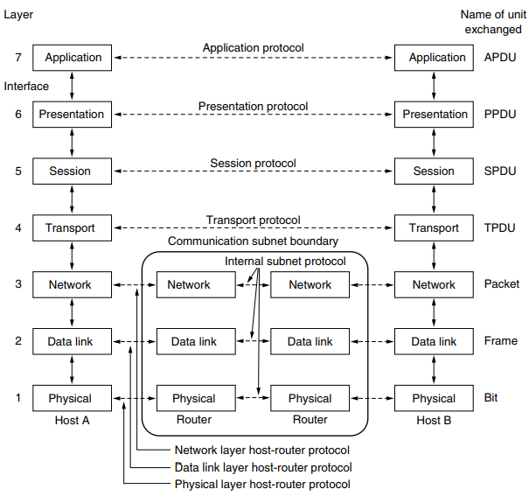

Slide 43
TCP/IP - Reference Model
OSI model mainly in ARPANET
When satellite and radio network added → existing protocol had trouble in working with them
New reference architecture needed
Design goal: ability to connect multiple n/w in a seem less way
4 layers
The Host –to- Network
The Internet Layer
The Transport Layer
The Application Layer

Slide 44
The Host –to- Network
A big void
Doesn’t say much about what really happens here
Designer can decide
Host connect internet by using some protocol and send IP packets to it
Protocol not defined → Varies from host to host & n/w to n/w
The Internet Layer
Job: permit host to inject packets to any n/w and have them travel independently to destination
Rearranging is the duty of higher layers : If in-order delivery is needed
It defines an official packet format & protocol : IP (Internet protocol)
Job is to deliver IP packets where it is supposed to go

Slide 45
The Transport Layer
Layer above Internet layer
Same as OSI
2 end-to-end transport layer protocol used here :
TCP (Transmission control protocol)
UDP (User Datagram Protocol) : Video, Audio
The Application Layer
TCP/IP model doesn’t have Session & Presentation layer
Contain all higher layer protocol
Eg: Virtual Terminal (TELNET), FTP, electronic mail (SMTP), DNS, HTTP etc

Slide 46
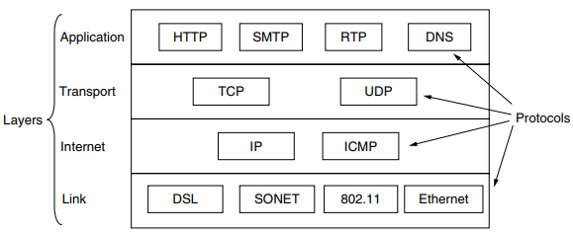
Protocols & Networks in TCP/IP

Slide 47
Comparisons OSI & TCP/IP
Similarities
Both based on stack of independent protocols
Layer functionalities are roughly similar
Layer above transport are application oriented
Differences
OSI | TCP/IP
7 layers | 4 Layers
Transport layer guarantee delivery of packets | Doesn’t guarantee
Horizontal approach | Vertical approach
N/W Layer provide both connection oriented & connection less service | Only connection less service
Defines Service, interface & protocols very clearly | Doesn’t clearly distinguish
Protocols can be hidden and easily replaceable | Not easily replaceable
Truly a general model | Cant be used for any other application

Slide 48
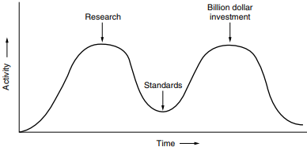
Critique of the OSI Model and Protocols
Bad timing
Bad technology
Bad implementations
Bad politics

Slide 49
Critique of the TCP/IP Reference Model
Doesn’t clearly distinguish Service, interface & protocols very clearly
Not a guide for designing new n/w using new technologies
Not a general model
Not suited to describe any other protocol stack than TCP/IP
Host – to – N/W is not a layer : Its like an interface
No physical & data link layer & its functions
Even minor protocols are harder to replace

Slide 50
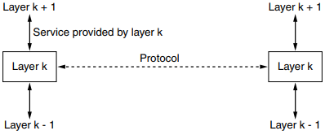
Service vs Protocols
Service | Protocols
Set of primitives | Set of rules
Defines what action a layer is prepared to perform | Defines the agreement b/w layers of communicating machines
Says nothing about implementation | Tells about how protocols are implemented
B/w layers of same machine | Different machines
Related to interface | Doesn’t

Slide 51

Syllabus - Module - I

Slide 52
Questions
Refer Note

Slide 53
Thanks

